Slide 1
Relational Reasoning
Relationship of object and human
Compositional Learning for Human Object Interaction, ECCV 2018
Learning to Detect Human-Object Interactions With Knowledge, CVPR 2019
Interact as You Intend: Intention-Driven Human-Object Interaction Detection, IEEE Trans on Multimedia 2019
20191003 Hyoungsung Kim
hyoungsung@gist.ac.kr
Notes:
Today i will introduce 3 papers about relationship of object and human
Second paper and third paper are written by same authors. So these are use similar architecture.

Slide 2
Compositional Learning for Human Object Interaction
Publish : ECCV 2018
Notes:
Title of First paper is Compositional Learning for human object interaction
This paper was published at ECCV in 2018

Slide 3
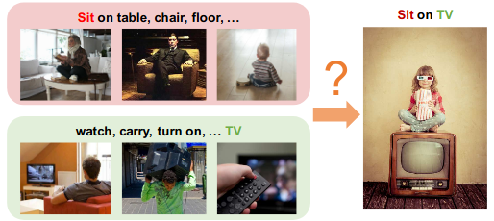
Contribution of this paper
Previous approaches about modeling actions and human-object interaction(HOI) require a lot of data
It is weak to new categories(zero shot learning)
Authors mentioned, zero shot learning is “Categories at testing time are not presented during training”
To handle unseen categories, authors propose a model with method using external knowledge graph and graph convolutional network
Notes:
I will introduce contribution of this paper first.
Previous approaches about modeling actions and human-object interaction require a lot of data.
However, as we know there is no perfect dataset. So distribution of data is not uniform.
For example, sit on table might be very common in dataset. however, sit on TV is not.
So in these paper, to handle unseen categories, authors propose a model with method using external knowledge graph and graph convolution network

Slide 4
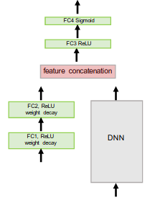
Intuitive understand of this paper
This part is replaced to Graph
Basic architecture for ZSL
Notes:
And i mentioned zero-shot learning in last slide.
I think we already know what is zero shot learning. But for easy understand for this paper, i will introduce intuitie understand of this paper.
This architecture is basic architecture of metric based zero shot learning.
Roughly speaking, very roughly, The only difference is fully connected layers are replaced to graph network.
You will be able to understand what i am saying soon

Slide 5
What is compositional learning
Human actions are naturally compositional and humans have amazing ability to achieve similar goals with different objects and tools.
For example, while one can use hammer for the hitting the nail, we can also use a hard-cover book for the same purpose.
We can leverage this unique composition to help recognizing novel actions.
Notes:
So to understand this paper, we have to know what is compositional learning and why machine need compositional learning
(Read slides)

Slide 6
How…?
How can a model learn to compose a novel action within the context?
Authors propose to explore using external knowledge to bridge the gap of contextuality, and to help the modeling of compositionality for human object interactions.
Specifically, authors extract Subject, Verb and Object (SVO) triplets from knowledge bases to build an external knowledge graph.
These triplets capture a large range of human object interactions, and encode our knowledge about actions.
Notes:
gap of contextuality : 하드 커버 책을 망치 대신 사용하게 하는 방법을 어떻게 알게 할 것인가?
How can we let machine do a kinds of compositional learnings?
(read slide) -> authors propose to explore …

Slide 7
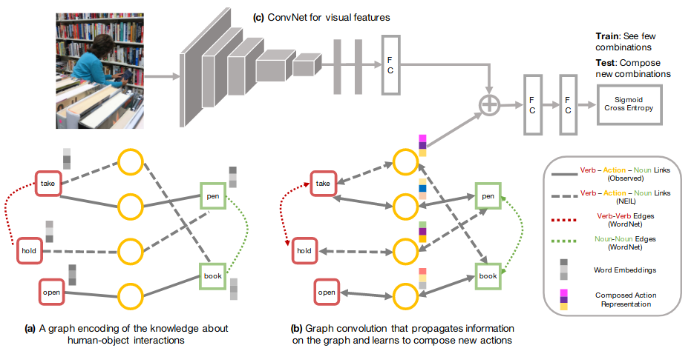
Model architecture - overview
Notes:
This is a architecture that proposed in this paper.
I mentioned that it has very similar architecture with basic zero shot learning. the only difference is this graph networks.
I will explain detail soon.

Slide 8
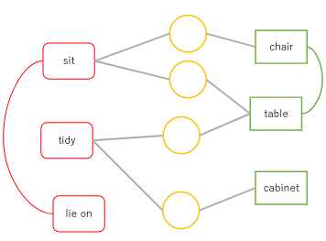
Graph representation of interactions
Pairs of verb-noun nodes are linked via action nodes (yellow circle), and verb-verb/noun-noun pairs can be connected.
These action nodes start with all zero features, and must learn its representation by propagating information along the graph during training.
This information passing is achieved by using a multi-layer graph convolutional network
Notes:
First, let me explain graph representation of interactions.
(Read slide)

Slide 9
Model architecture - Encoding knowledge
In this part, it encodes SVO(subject, Verb, Object) pairs to graph
Each verb or noun is represented as a node and comes with its word embeddings as the node’s features. (word embedding : A kind of way to map natural language to vector space)
Verb and noun are connected by observation or external knowledge (WordNet : data from dictionary database, NEIL : data from web)
Notes:
We have to encode words for machine.
Because machine can not understand natural language. so we have to convert it for machine.
(Read slides)
word embeddings are used as features for graph convolution networks
You can see this picture.
Firstly, we only know observed pairs. like <pen, action, take>. However using external language we can make more edges.

Slide 10
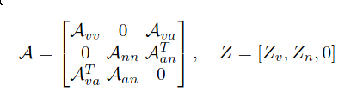
Model architecture - Graph convolutional network
Adjacency matrix of verb-verb
Z : Nodes features(Word embedding). Initial feature of action is 0
Learning will propagate features on the graph, and fill in new representations for the action nodes. These action features are further merged with visual features from a convolutional network (Remember at first time actions start with all zeros features)
Notes:
We need to do graph convolution network.
(Read slide)
A_vv is adjacency matrix of verb-verb. you have to be careful. It is not just element but matrix.
(Size of weight is input features dimension by output features dimension)
(Normalize graph : capture feature better)
And this is a result of a layer

Slide 11
Model architecture - Convolution, concatenate, and ge score
CNN extract visual features from image
Extracted features are concatenated with action representation of graph(Z) for zero shot recognition.
Notes:
And this is cnn layer. I think it is very familiar to us.
As we know, CNN extract visual features from image
Extracted features are concatenated with action representation of graph for zero shot recognition.

Slide 12
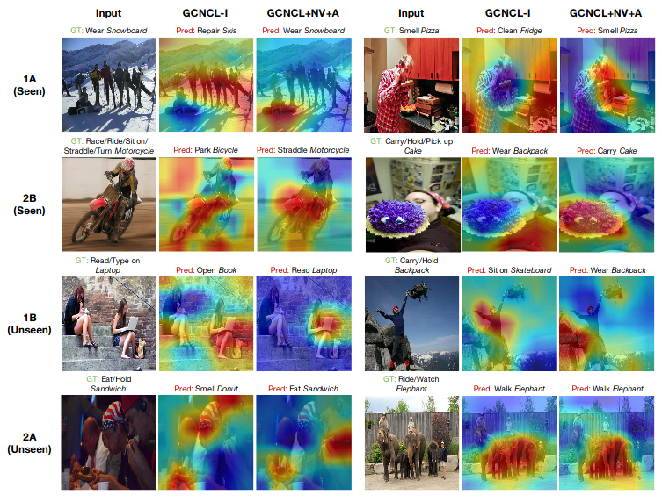
Result(Attention map using top-1 predict labels)
Red regions correspond to high prediction scores
GCNCL-I : Only include link of (verb, noun), (object, noun). e.g, There is no (verb, verb) or (object, object)
GCNCL : Add action edge using WordNet
A : Add action links from external knowledge(e.g., NEIL)
NV : Include new tokens(1 hop on WordNet)
1A, 2B, 1B, 2A : Name of subset
1 / 2 : Noun group
A / B : verbs group
For example, if 1A and 2B are used in training set, then 1B and 2A are not used in training
However testing set consists of {1A, 1B, 2A, 2B}
Notes:
(Authors mentions that this show best result.)
This is a result.
Red regions correspond to high prediction scores
1A and 2B are seen while training. so we can expect network find well
However, 1B and 2A are unseen while training. but network find answer successfully when external knowledges are given.
By this results, we can know the power of external knowledge for zero shot learning.
This column is result without external knowledge in graph. it shows that it cannot predict well.
However, when graph is combined with external knowledge, it shows good prediction even unseen images too,

Slide 13
Recap
It increase neighborhood nodes of graph using external knowledge
Therefore, it is possible to get more features in GCNN
These features are helpful to recognize unseen categories
Notes:
So let me recap it.
(Read slide)

Slide 14
Learning to Detect Human-Object Interactions With Knowledge
Publish : CVPR 2019
Notes:
Learning to Detect Human-Object Interactions With Knowledge is second paper which is published in CVPR 2019

Slide 15
Contribution of this paper
Authors focus on detecting human-object interactions(HOIs) in images, an essential step towards deeper scene understanding.
However, HOI categories exhibit a long-tail distribution
i.e., there exists some rare categories with very few training samples
For example, the number of “person riding a bike” > the number of “person riding elephant” in training sets
Authors tackle the challenge of long-tail HOI categories by modeling the underlying regularities among verbs and objects in HOIs as well as general relationships.
Namely, to solve a problem, authors propose multimodal joint embedding learning
Notes:
This is a contribution of this paper
(Read slide)
You can see this picture.

Slide 16
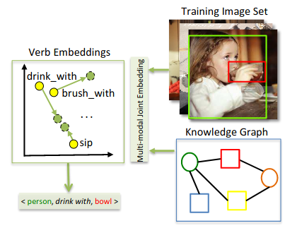
Conceptual illustration of multi-modal joint embedding learning
The proposed model learns a semantic structure aware embedding space compared to original word embeddings, such that it can leverage semantic similarity to retrieve the verb(s) best describing the detected <human,object> pair.
In the original word embedding space(Yellow color circle in left image), “drink with” is mapped to be close to “brush with” possibly because of the shared “with” from word vector embeddings.
With the joint update from knowledge graph and training imageset, the model is more likely to comprehend the meaning of “drink” as its neighbors include “sip”(Green color).
Notes:
In this slide, I will briefly introduce concept of this paper
(Read slide)
You can see that drink becomes close to sip

Slide 17
Compare with first paper and second paper
Commonalities
Both are leverages semantic regularities from linguistic knowledge(and external knowledge)
Differences
First paper of this slide do not explicitly consider the joint impact from the referent source and visual information.
In contrast, second paper(Current paper) emphasizes on the joint update of the verb embeddings from vision and linguistic knowledge by introducing a multi-modal embedding module to dynamically learn the semantic dependencies of the concepts
In the context of HOI detection that verbs and interacting objects are linked with semantic structures.
Notes:
Then you might be curious what is a difference between first paper and second paper.
Because each paper is using external knowledge.
Same thing is (Read slide)

Slide 18
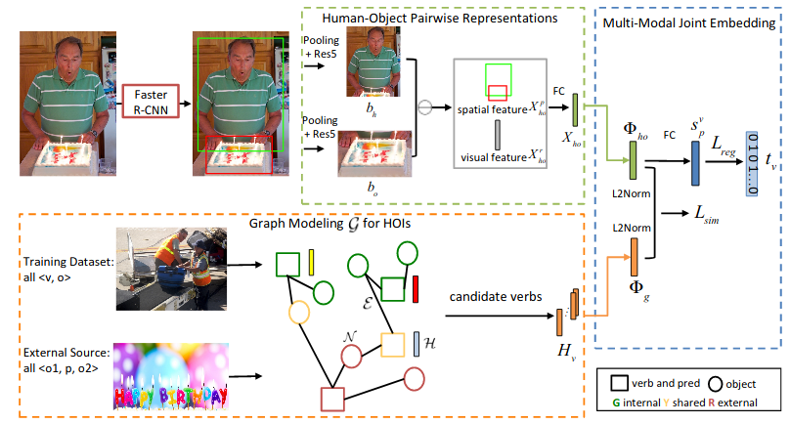
Illustration of the proposed verb embedding learning
Notes:
(Why substrat? for visual translation embedding -> reference에서 가져왔음
b_h or b_o is visual appearance
S_p^v : score of spatial configuration. (spatial configuration : location)
X : representation
X_{ho} : pairwise representation
You can see make concept clear using these images.
I will explain detain in next slides

Slide 19
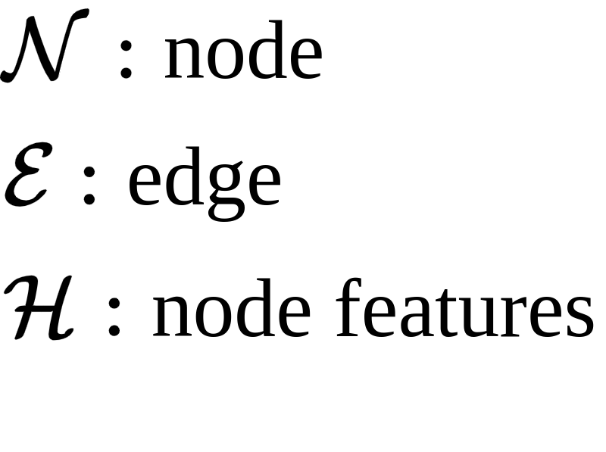
Detail - Graph modeling
In order to boost learning of long-tail classes, authors exploit a graph-based approach to model the semantic dependencies from linguistic knowledge complementing the training visual representations
Specifically, the graph structure is used to capture the semantic dependencies amongst verb and object categories in HOIs, and general visual relationships.
Edges connect valid pairs. As a result, the tail verb classes are impacted from its neighbors on the same object node. (e.g. “person ride bike“ and “person ride elephant“ share object.)
Exactly, training dataset and visual relationship dataset are connected.
Notes:
pred : predicate(술부)
첫번째 논문과의 차이점 : edge연결 하는 방식이 다름. 첫번째에서는 외부 정보를 이용하여 주어진 데이터사이를 연결
여기서는 외부 정보와 주어진 데이터를 연결
First graph modeling.
(Read slide)
There exists 2 dataset. one is training set and the other is external knowledges.
You can remember that first paper also use external knowledge. But a difference is
Fist paper uses external knowledge to make additional edges.
But in this paper, external knowledge is used to make new nodes.

Slide 20
Detail - Human-Object Pairwise representations
Fully connected
and
element-wise substarction
Given a detected person bh and a detected object bo, the learned pairwise representations should preserve their semantic interactions and the relative location configuration.
For example, the interaction (e.g.sit) can be characterized by the visual appearance
Element-wise subtraction is used to get a visual translation embedding
Notes:
Substarction : For visual embedding
b_h or b_o is visual appearance

Slide 21
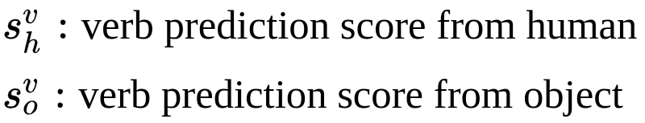
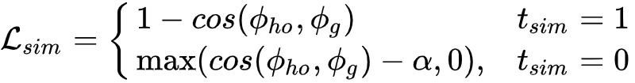
Detail - Multi-modal Joint Embedding
The objective of the joint embedding learning is to maximize the similarity between positive L2Norm and minimize it between all non-matching pairs to a specified margin
Intuitively, we want to get a similar result(similar verb) from CNN and GCNN
v is a verb of training set in graph
Notes:
\pi의 결과는 벡터 -> 벡터끼리 cosine similarity 계산 함
v는 그래프 입력의 verb
And next is detail of multi modal joint embedding
(Read slide)
This is a objective function
One thing to note is Loss of similarity uses a cosine similarity depend on association in ground-truth

Slide 22
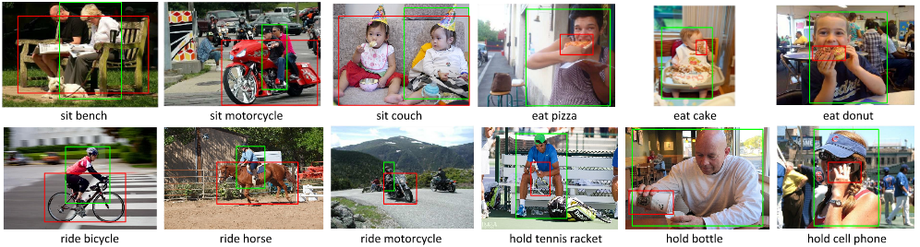
Result
Evaluation : correctly detect all of the <human,verb,object> triplets for an image(True positive).
The predicted triplet label is the same as the ground-truth
both the predicted human and object bounding boxes have intersection-over-union (IoU) greater than 0.5 w.r.t the ground-truth annotations
Notes:
And Let’s see a result.
(Read slide)

Slide 23
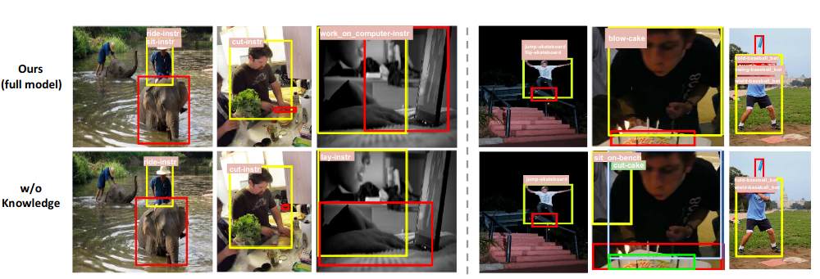
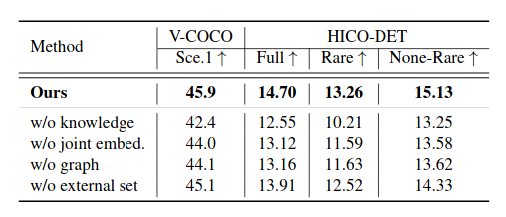
Ablation study
Mean average precision
w/o knowledge : use CNN only
w/o joint embedding : Concatenate results of cnn and knowledge. And pass it to Fully Connected layer
w/o graph : feed word2vec instead of result of knowledge graph
w/o external set : it uses graph but there is no external knowledge
(Full) all 600 HOI categories in HICO, (Rare) 138 HOI categories with less than 10 training instances, (Non-Rare) 462 HOI categories with 10 or more training instances.
Notes:
This is a ablation study.
First rows uses a external knowledge and second one is not
It shows that external knowledge helps to recognize long-tail data
Table shows quantitative result. You can see that when external knowledge is used, it shows best results.
In HICO-DET dataset, there is 3 categories.
Full means all of dataset.
Rare means a long tail data

Slide 24
Recap
In first paper, external knowledges are used to extend a connection of training data (i.e., External knowledge is used to make new edges)
But in this paper, external knowledges are connected to training dataset (i.e., External knowledge is used to make new nodes)
Multi-modal embedding module uses vision and linguistic information to detect human-object interaction.
Notes:
This slide is for recap of second paper.

Slide 25
Interact as You Intend: Intention-Driven Human-Object Interaction Detection
Publish : IEEE Trans on Multimedia 2019
(Same authors with second paper)
Notes:
And this is 3rd paper. It is written by same author group of second paper.
So it uses similar structure with second paper.

Slide 26
Contribution of this paper
Authors provide a unique computational perspective to explore human intention in HOI detection.
Specifically, the proposed human intention-driven HOI detection (iHOI) framework models human pose with the relative distances from body joints to the object instances.
In this work, Authors provide a novel computational perspective to exploit two forms of human intention that is visually observable:
Human gaze, which explicitly conveys intention
Human body posture, which implicitly conveys the intention.
In contrast to previous works treating humans and objects similarly, with no consideration that human behaviors are purposeful, authors argue that human intention drives interactions.
Therefore, in this work, authors exploit the cues in an image that reflect an actor’s intention, and leverage such information for more effective HOI detection
Notes:
This is contribution of this paper.
(Read slide)
(human intention has yet been investigated in the context of HOI detection in an integrative manner)

Slide 27
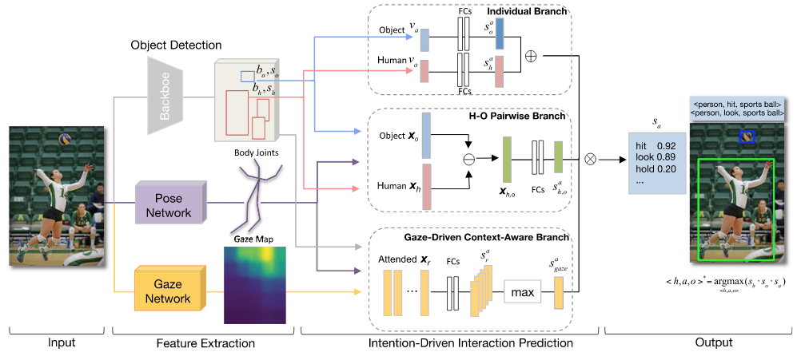
Proposed model architecture
The proposed intention-driven HOI(iHOI) takes an image as input for feature extraction and human intention-driven interaction prediction, and outputs the detected triplets(<human, hit, sports ball>).
Goal is finding best action score.

Slide 28
Detail - Feature Extraction
It uses faster R-CNN(same with second paper) for object detection.
Human body joints locations and gaze direction are obtained through transfer learning from other social-activity datasets, since authors’ aim is to effectively model intention rather than extract features, and both experimental datasets lack the ground-truth.
Output of gaze network : probability density map
Notes:
I will introduce feature extraction first.
(Read slide)
One thing to note is output of gaze network is probability density map

Slide 29
H-O Pairwise Branch
we aim to learn a pairwise feature embedding that can preserve their semantic interactions.
Basically, it is same with second paper’s one.
However, it extends the feature space with human pose information.
Human pose bridges the human body with the interacting object.
Feature representation X includes encoded pose information(encoding : distance from each joint)
Notes:
This part is for human object pairwise branch
In this branch, it focus on getting semantic interactions.
(X : visual appearance, relative spatial layout and object semantic likelihood)

Slide 30
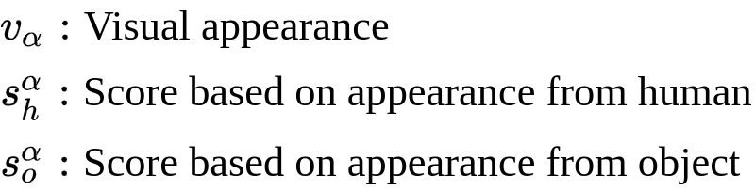
Individual Branch
The shape and size of an object can help to infer action
Calculate scores from human and object
Scores are fused by element-wise summation
Notes:
In individual branch, it focus on visual appearance.
(Read slide)

Slide 31
Gaze-Driven Context-Aware Branch
We observe that the regions where an actor is fixating often contain useful information for the interactions.
Therefore, we exploit the fixated contextual information to help recognizing the actor’s action
In particular, we use human gaze as a guidance to leverage the fixated scene regions
Notes:
(x,y) of G : location point of b
(Read slide)
Let’s see more detail in next slide

Slide 32
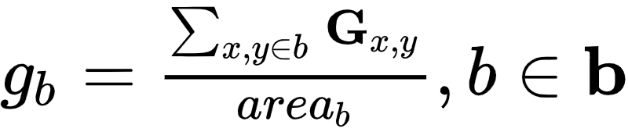
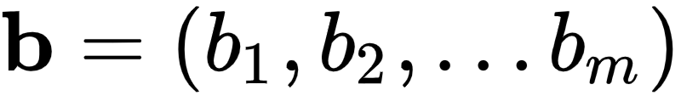
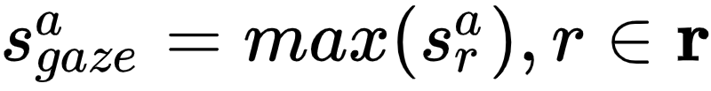
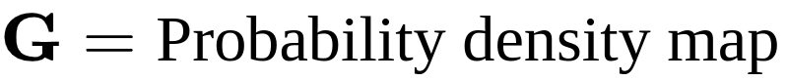
Gaze-Driven Context-Aware Branch(Continue)
Score(S) : Results of FC layers
b is region from object detector
Calculate score for each region(r)
Notes:
(x,y) of G is location point of b
b is objects
score : result of prediction
intuitively, we want to find important area of object
for example, there is area of ball. then we can think that in area of ball, this location has high probability density
X is features of region
we get a score for each region

Slide 33
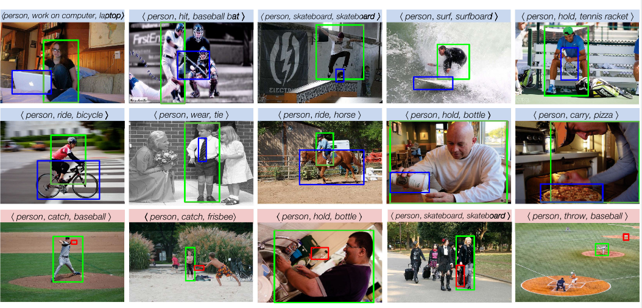
Result
Top 2 rows : correct prediction
Last low : false positive
Notes:
This is result.
It successfully find human-object interaction. and
Second rows shows false positive things.

Slide 34
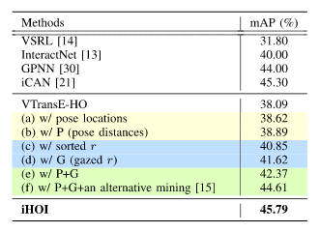
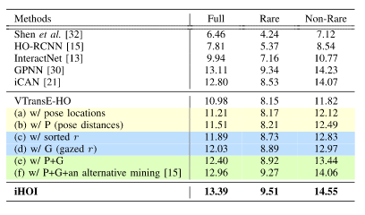
Result(Continue)
V-COCO dataset
HICO-DET dataset
VTransE-HO is visual translation embedding network. It is used as base framework.
w/ pose locations : The relative locations of body joints
w/ P (pose distances) : The relative distances from body joints to the instance
w/ sorted r : additional context-aware branch instead of gaze (w/o pose)
w/ G(gazed r) : additional gaze-driven context-aware branch (w/o pose)
w/ P + G : Body joints distances and gaze information
w/ P + G + reference : authors show this result to compare with other strategy
iHOI : Authors reimplementation of VTRansE-Ho with their ways
Notes:
(mAP_role : AP of triplet<human, verb, object>)
We focus on iHOI not HOI
(w/ sorted r : I think it is one of things that embedded in VTransE-HO)

Slide 35
Q & A

